Slide 1
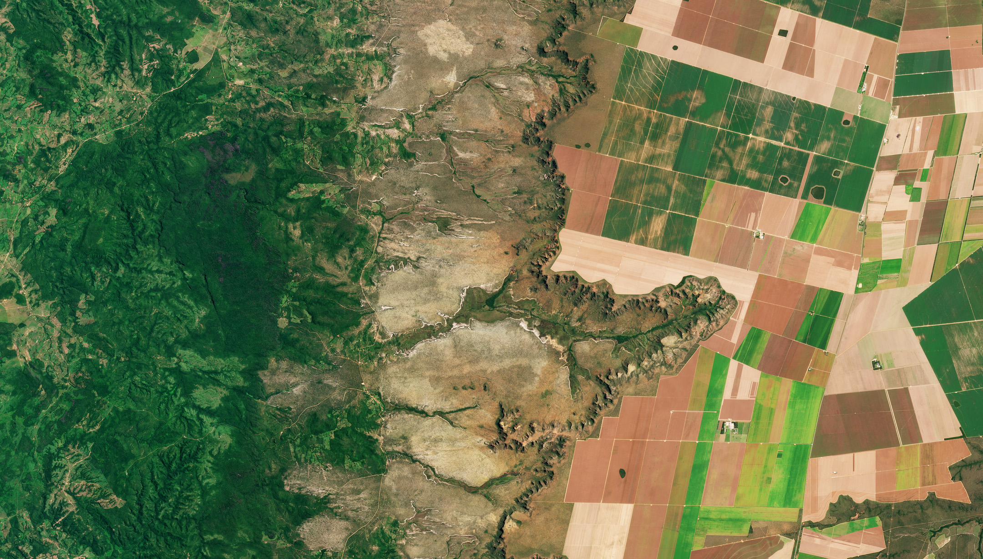
Satellite Image Classification
Capstone 3 Project: Springboard Data Science Career Track

Slide 2
Project Problem and Stakeholders
Problem: create a model that can classify satellite images according to whether or not they contain tress/are forested.
Use-Cases for this Solution:
Classifying the same geographic area on a regular basis in a zone that is at risk for illegal timber harvesting or land clear-cutting
Monitoring progress of an area where reforestation is underway following a wildfire
Estimating biomass extents where ground truth evidence is not available
Land use planning for commercial timber operations

Slide 3
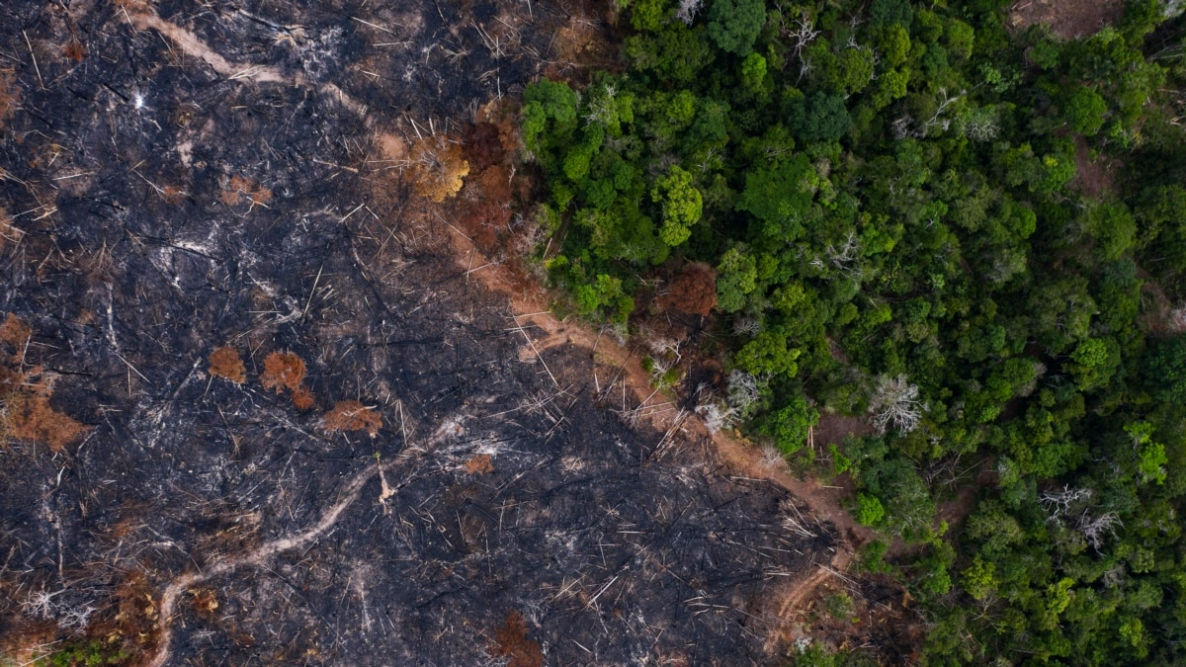
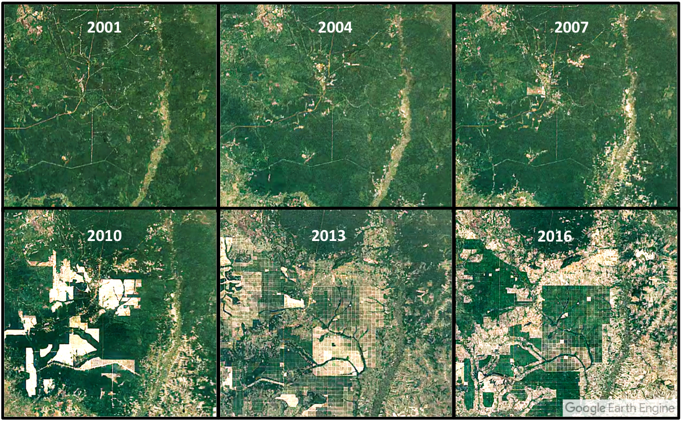
Monitoring progress of an area where reforestation is underway following a wildfire
Classifying the same geographic area on a regular basis in a zone that is at risk for illegal timber harvesting or land clear-cutting

Slide 4
Project Synopsis
I used created convolutional neural networks (CNN) with Keras and TensorFlow libraries using scratch-built and transfer learning architectures that achieved over 98% classification accuracy.

Slide 5
Data Wrangling
The dataset consists of a balanced, labeled set of 10400 images total with 5200 images in each class (forested, non-forested).
Each image is a 3-channel (RGB) jpg of 64x64 pixels.
The dataset is compiled and available on Kaggle.
No additional wrangling or processing of the images was necessary.

Slide 6


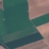
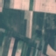
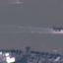

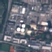
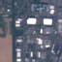
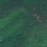
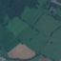
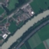
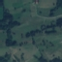
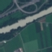
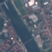
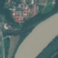
Exploratory Data Analysis
A selection of images from each class:
No Trees
Trees

Slide 7
Modeling: Scratch-Built
I explored scratch-built models with various architectures:
varying numbers of convolutional layers
varying numbers of neurons in the convolutional and dense layers
different activation functions
different optimizers
different learning rates
with 80/20 and 75/25 train-test splits

Slide 8
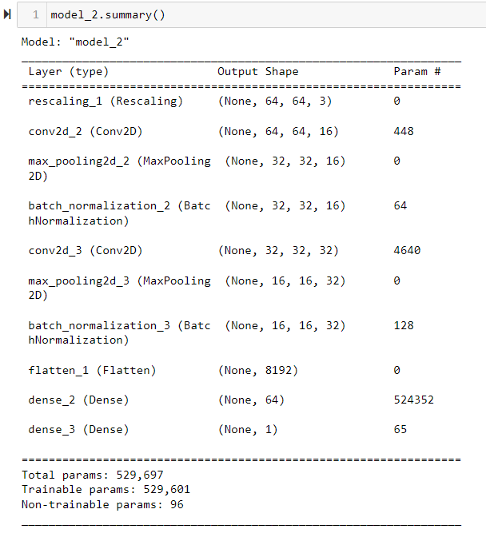
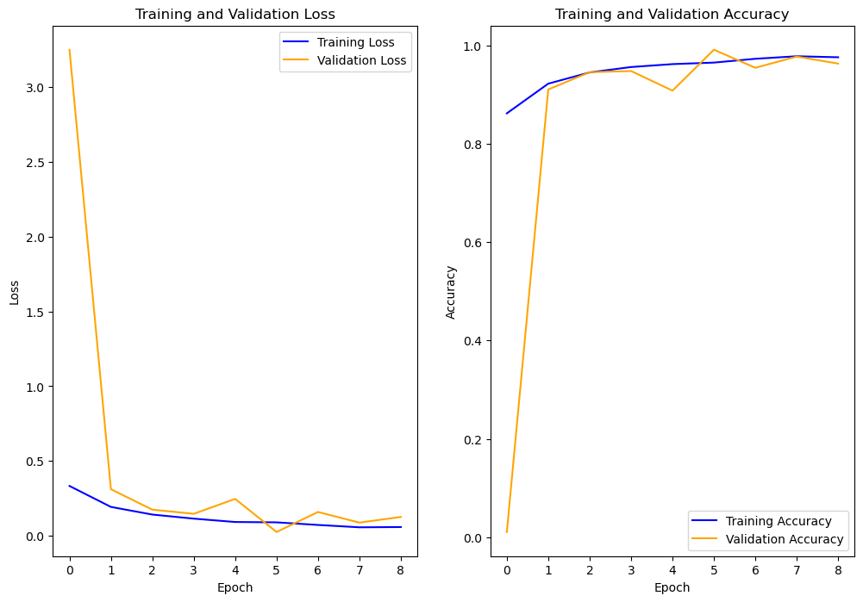
Modeling – Best Scratch-Built

Slide 9
Modeling – Transfer Learning
Start by adding a dense layer on top of pretrained model to serve as feature extraction model
Then fine-tune: unfreeze a number of top layers of base model to allow weights to be updated to training data.

Slide 10
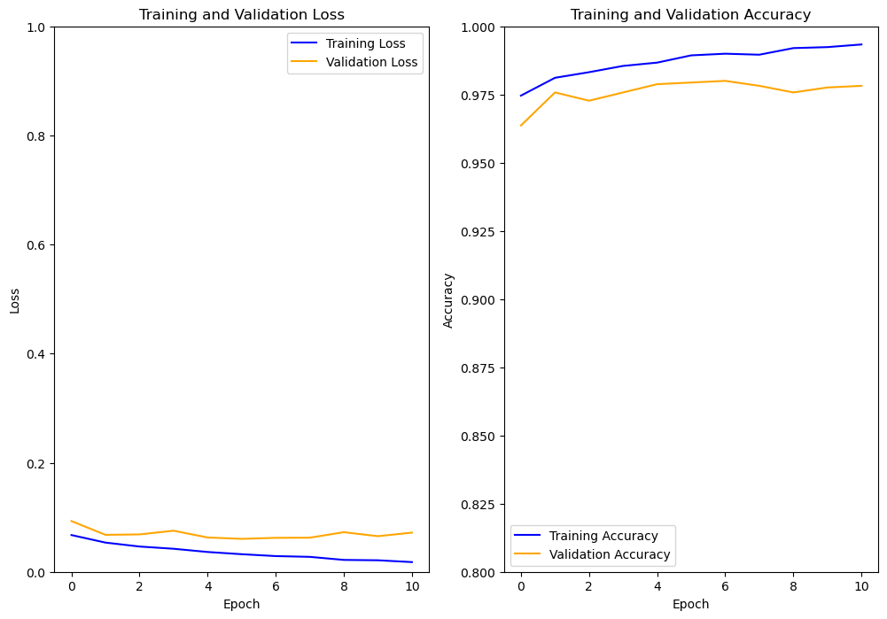
Modeling – Transfer Learning with MobileNetV2
Fine-Tuned epochs:
Fine-Tune top 14 layers
Accuracy ~ 98%
Loss ~0.07

Slide 11
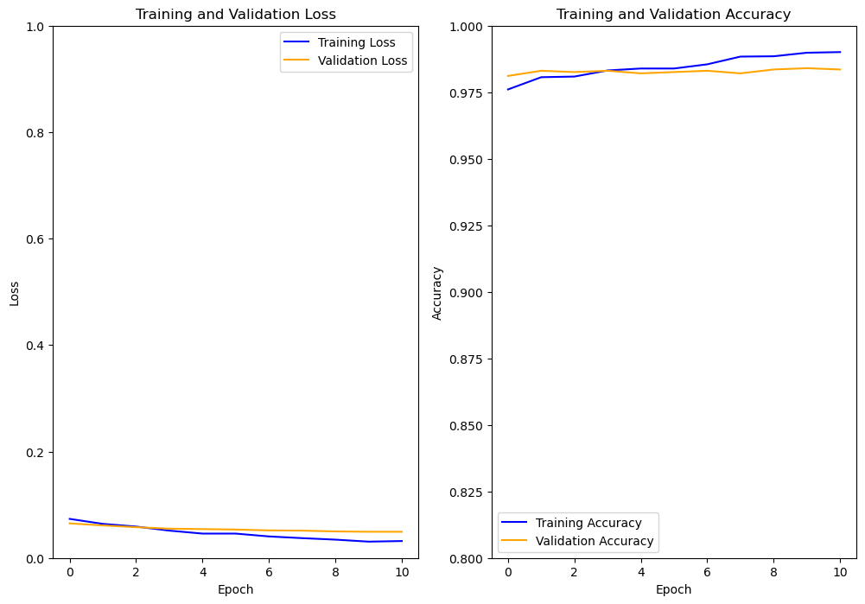
Modeling – Transfer Learning with ResNet50
Fine-Tuned epochs:
Fine-Tune top 4 layers
Accuracy > 98%
Loss ~0.05

Slide 12
Model Selection

Slide 13
Model Selection
Both transfer learning models achieve good accuracy on validation and test sets.
If the model will be updated frequently with additional training data, the better choice would be the MobileNetV2 model, because the training time is less than half that of the ResNet50 model.

Slide 14
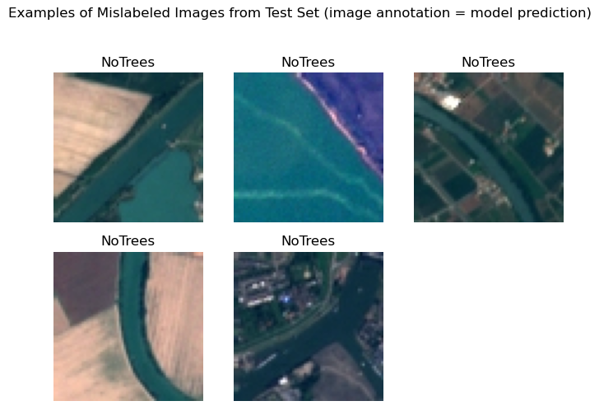
Further Investigation:
Try a similar classification model but with additional spectral band information (ie near infrared bamds used in remote sensing for vegetation mapping)

Slide 15
Thank You
Project on GitHub including Notebooks and Report:
https://github.com/ehardwick2/Satellite_Image_Classification#readme

